Slide 1
Smart Traffic Management System
Maha Mohammed 202002565
Noor Jaafar 202007922
Adnan Mohammed Redha 202008997
Aisha Jassim Altemimi 202007058
Sayed Ahmed Khalaf 202007602
Fai Omar Albabtain 202011749

Slide 2
Problem Description
Traffic congestion is a significant issue in urban areas, leading to increased travel times, higher fuel consumption, and elevated pollution levels. Efficient traffic management is essential for improving urban mobility and reducing environmental impact. The Smart Traffic Management (STM) system aims to optimize traffic flow by dynamically adjusting traffic signal timings based on real-time data collected from various sources such as cameras and sensors. This system leverages AWS services to handle image processing, data processing, and storage to enhance traffic management efficiency.

Slide 3
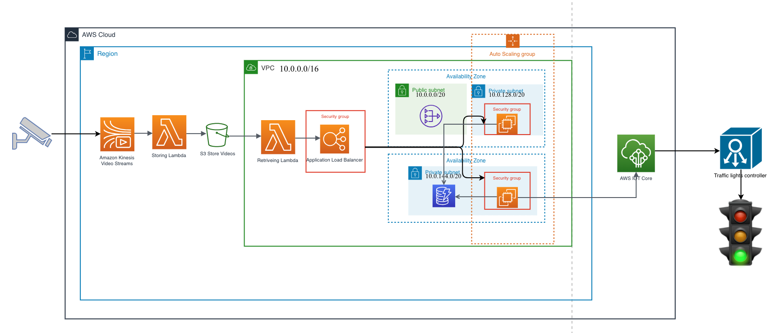
Infrastructure Design
The STM system is designed using AWS services to create a robust, scalable, and secure architecture. The key components of the infrastructure include:

Slide 4
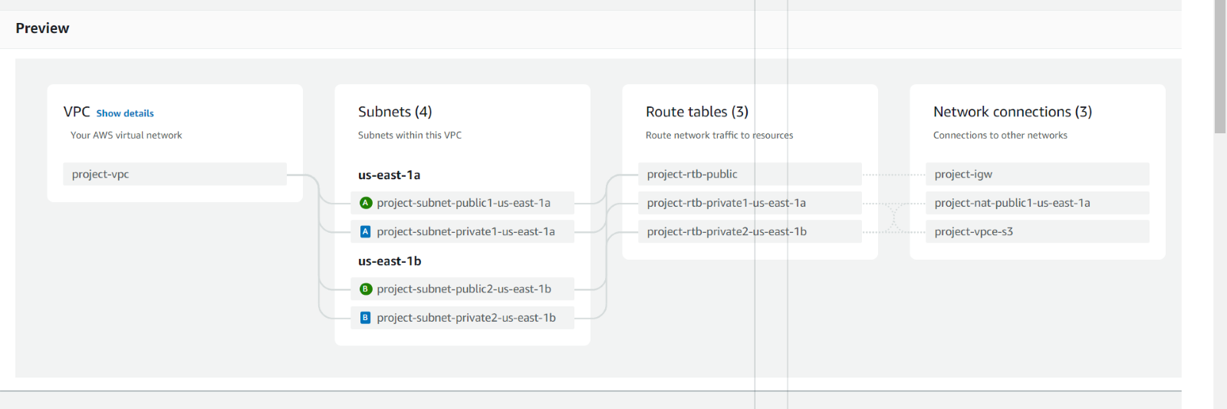
Procedure:
The first step for building the infrastructure is creating a VPC with address (10.0.0.0/16) containing two availability zones.

Slide 5
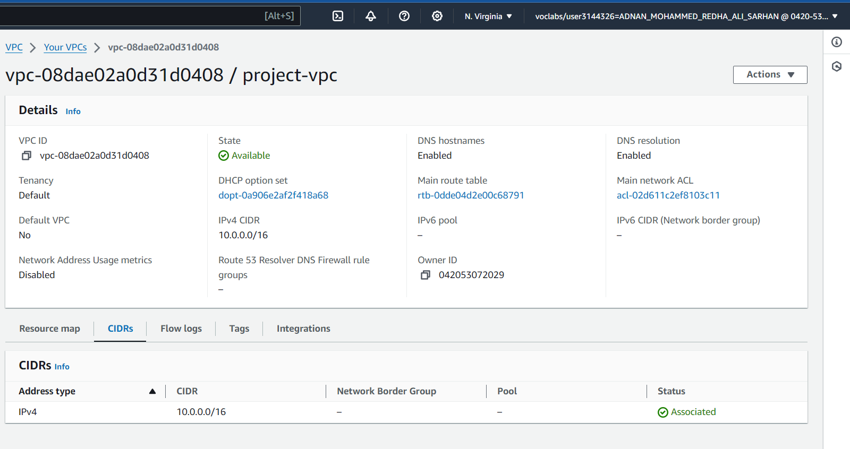

Slide 6
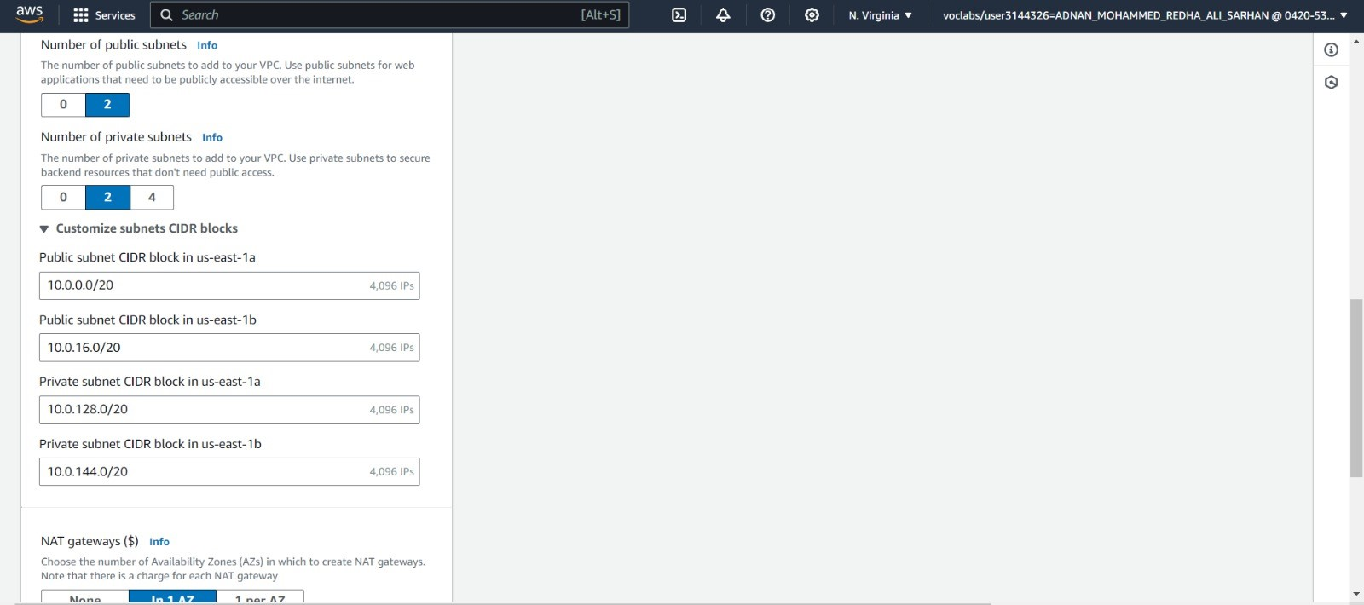

Slide 7
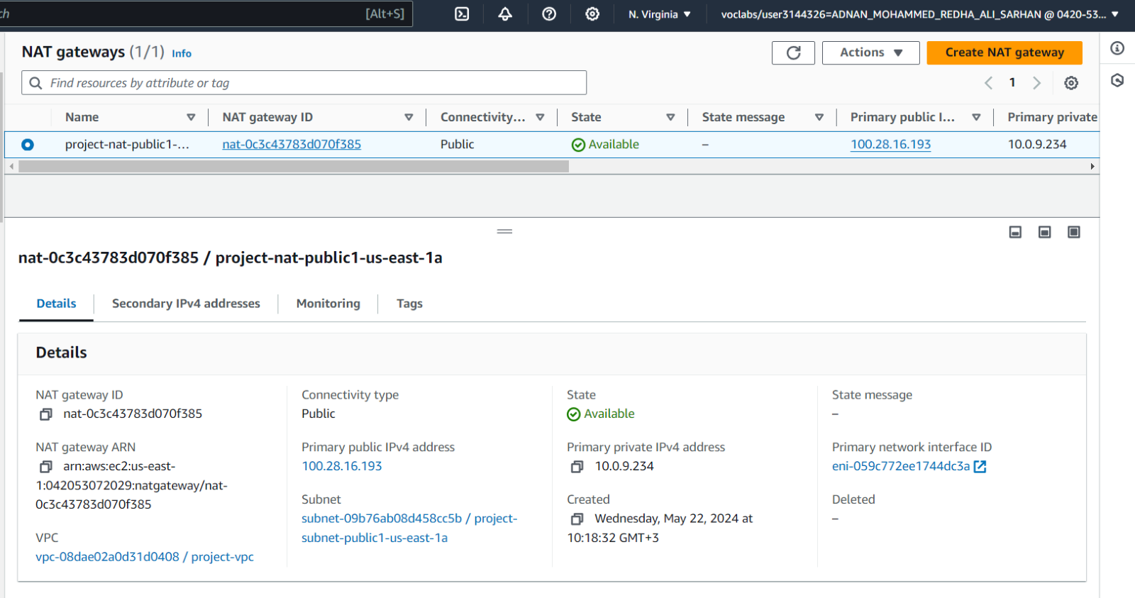
A Network Address Translation (NAT) gateway link between private and public networks, allowing the private network a secure connection to the internet. NAT gateways enable instances in the private subnets to get access to the internet securely.

Slide 8
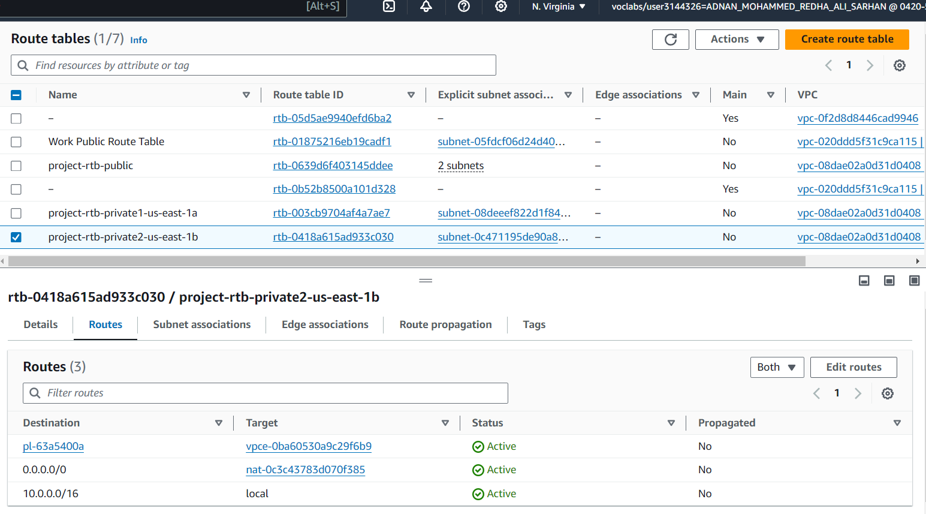
The routing table contains routes (set of rules) which specifies target and destination for each route, and it controls the inbound and outbound traffic for a subnet. Two routing tables were created for both public subnets with the same configurations.

Slide 9
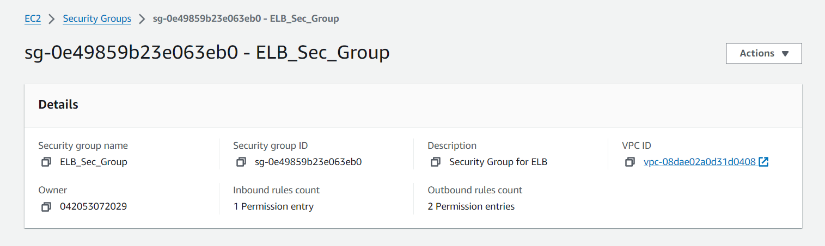
Security groups act as a virtual firewall that manages inbound and outbound traffic. We added security groups for the load balancer and the two EC2 instances. We allowed all outbound traffic and restricted the inbound traffic as shown in the figures.

Slide 10
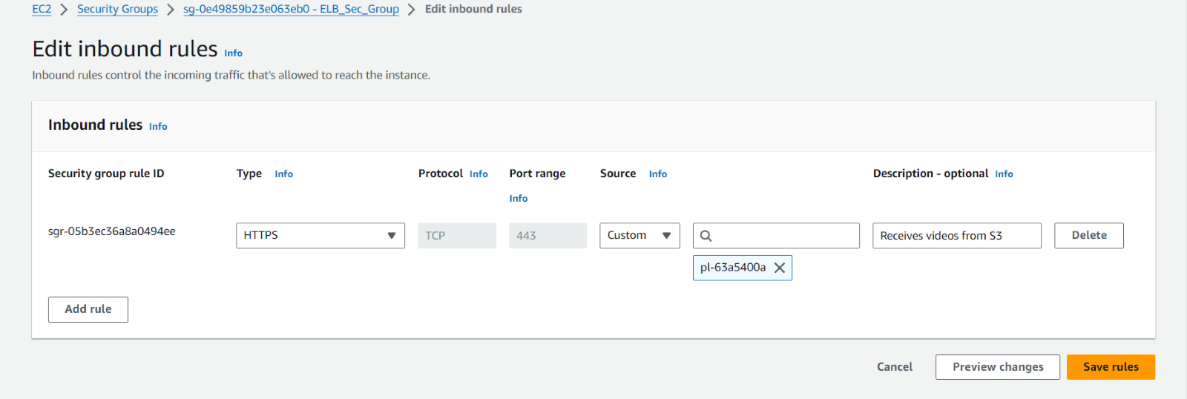
Load Balancer’s Security Group Inbound Rules:

Slide 11
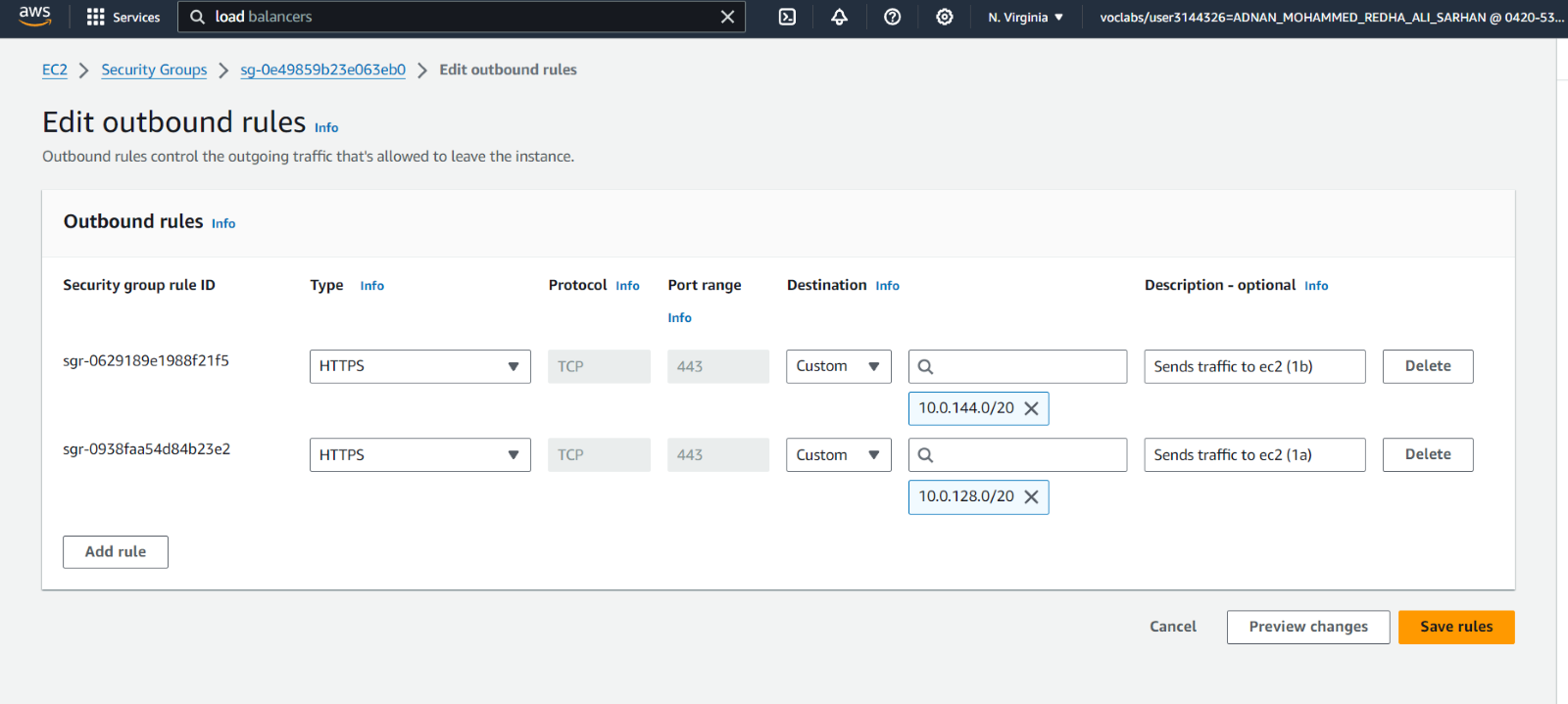
Load Balancer’s Security Group Outbound Rules:

Slide 12
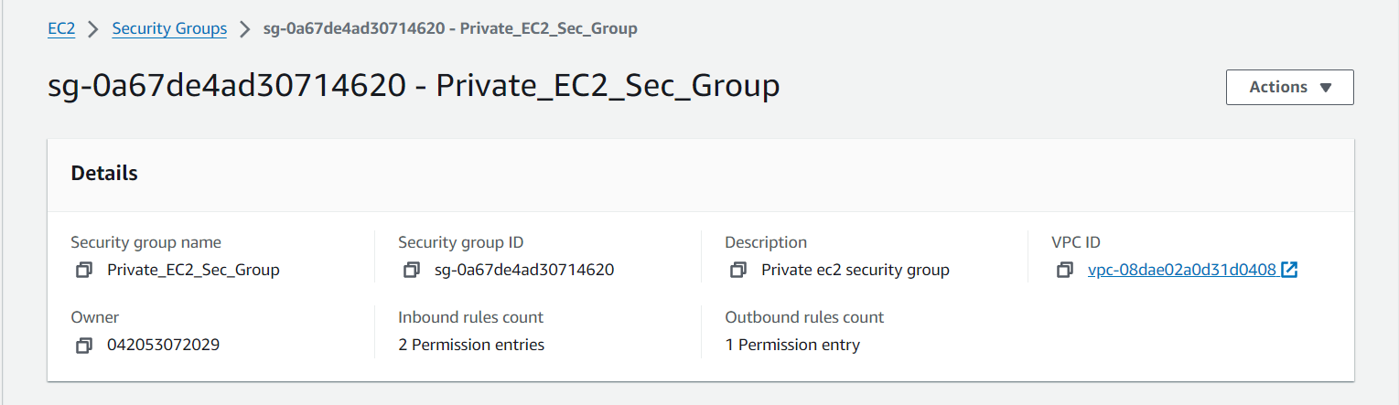
EC2:

Slide 13
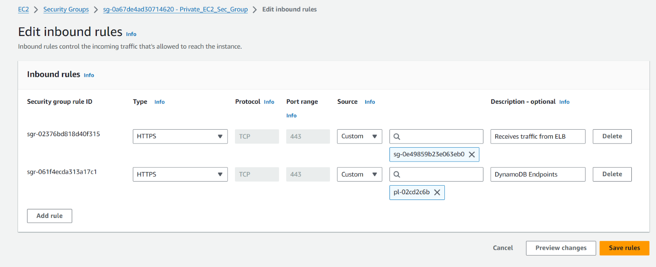

Slide 14
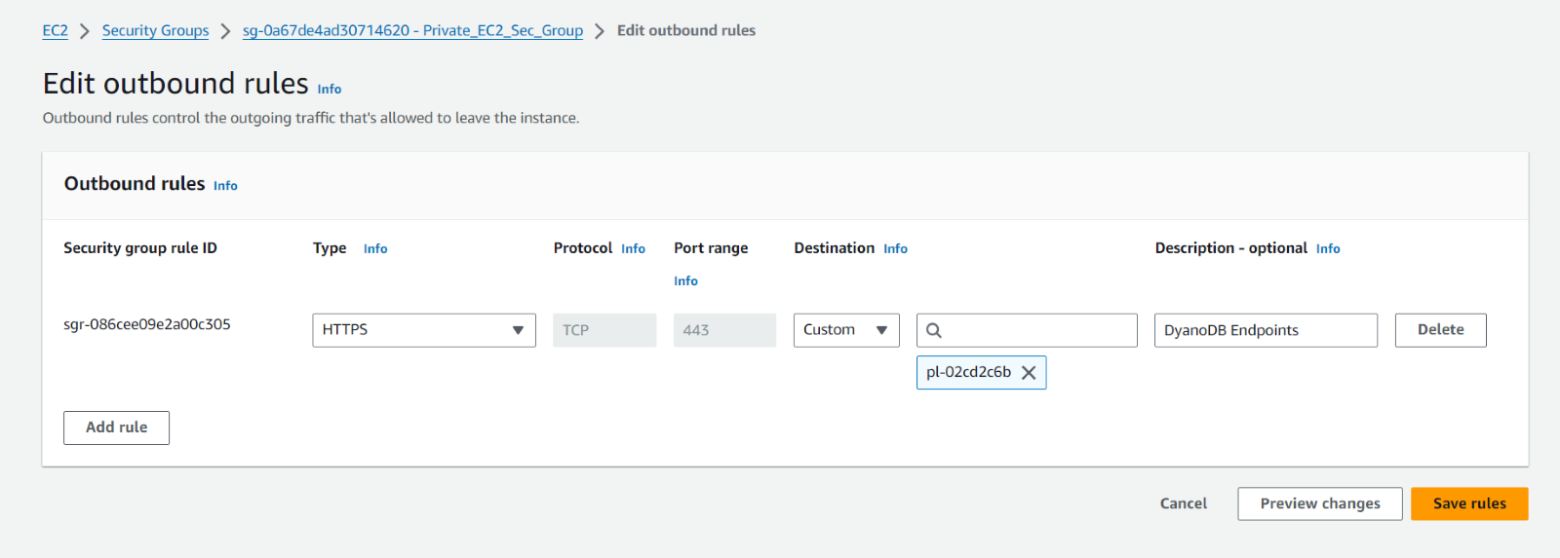

Slide 15
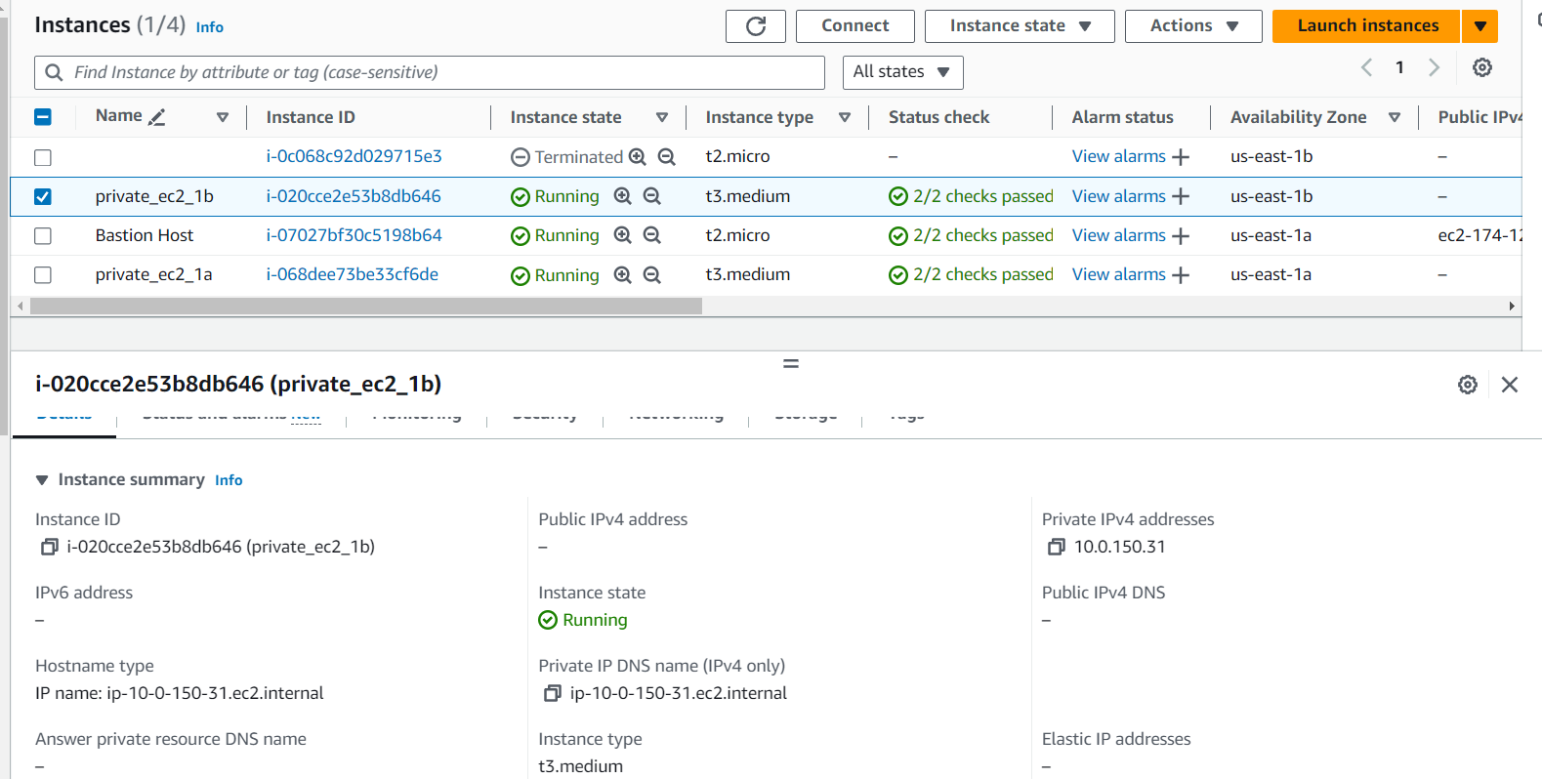
Instances:

Slide 16
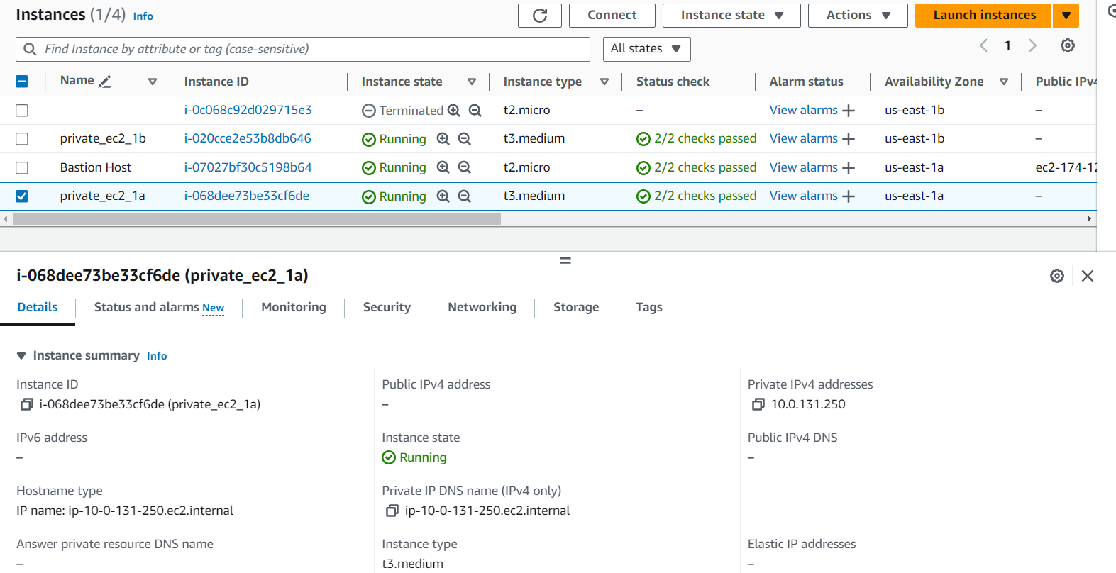
Instances:

Slide 17
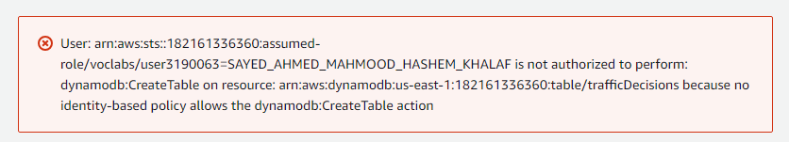
The traffic decisions made must be stored in DynamoDB, the results of the machine learning model and a reference to the video stored in S3 are retained here. The aim of performing such a task is to have previous decisions stored for any retraining necessary that might occur to the model. However, when trying to create a DynamoDB table, the following error keeps popping up. :

Slide 18
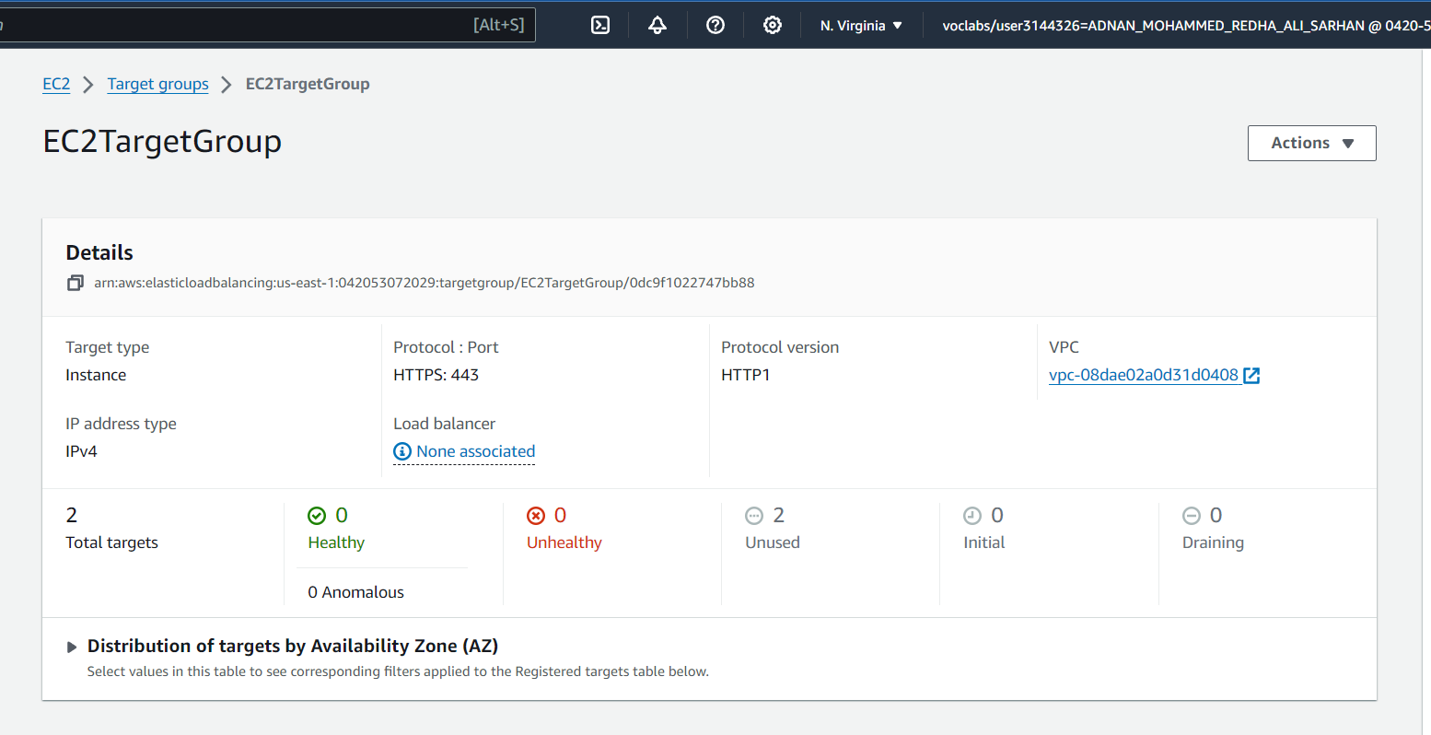
Target groups and load balancers:

Slide 19
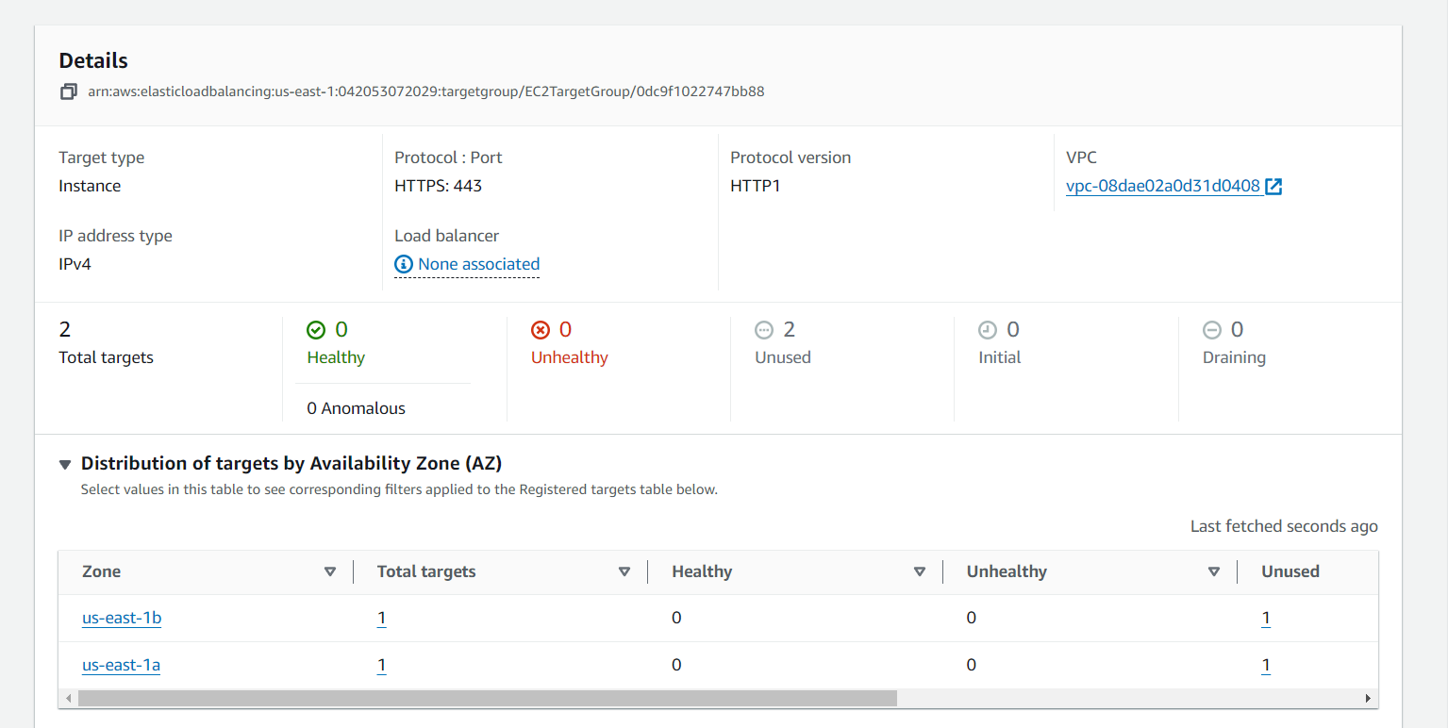

Slide 20
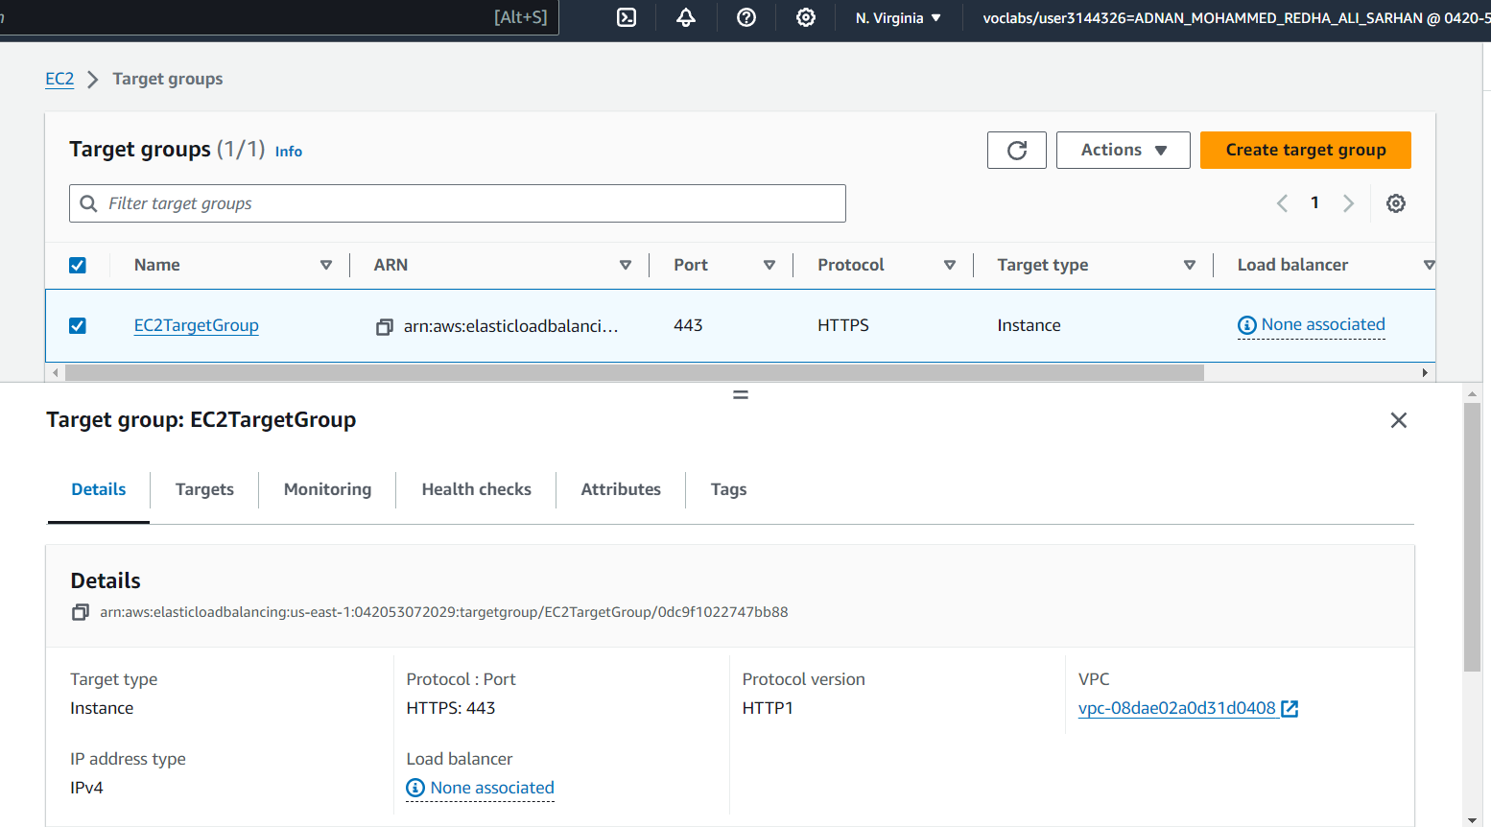

Slide 21
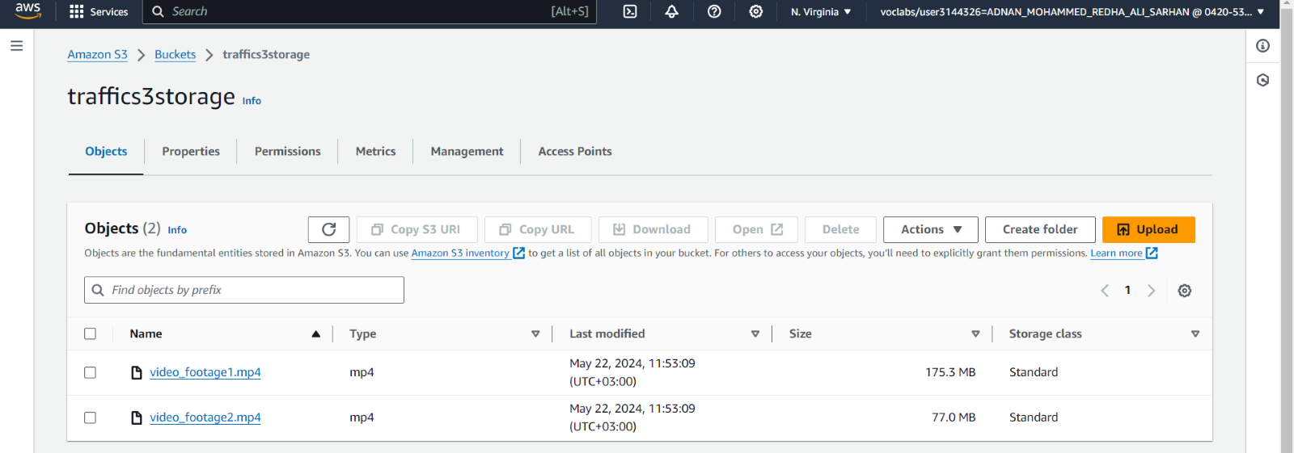
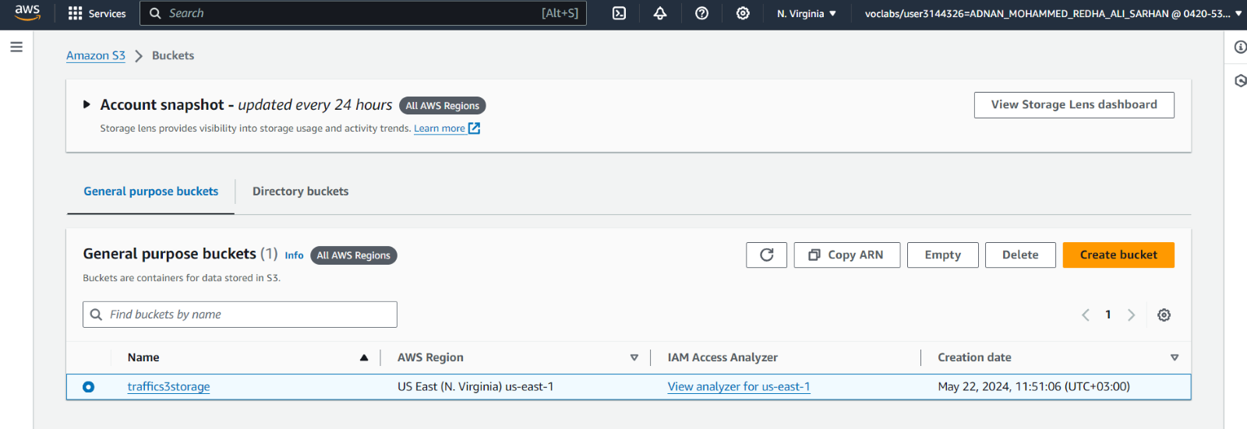
The S3 bucket contains traffic videos that are sent from the cameras every 15 seconds since we need continuously new data.

Slide 22
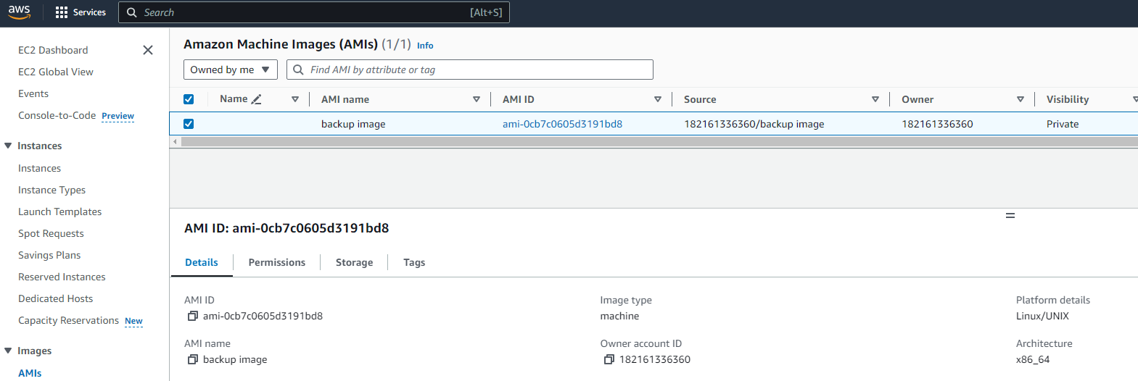
An image was created from the EC2 instances for the purposes of reliability and efficiency in the case of any failures.

Slide 23
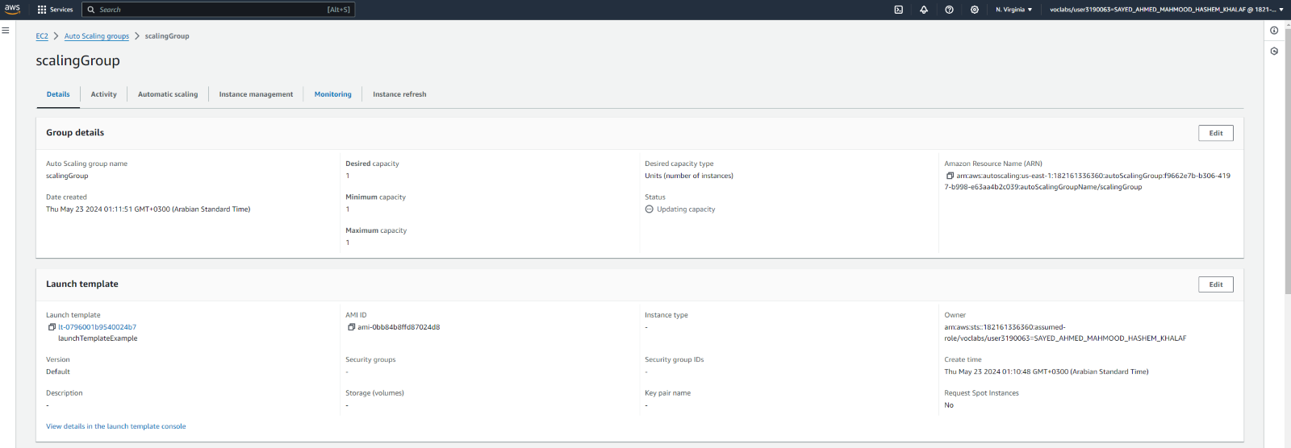
An Auto Scaling group can be thought of as a collection of EC2 instances grouped together logically for the goal of automatic scaling.

Slide 24
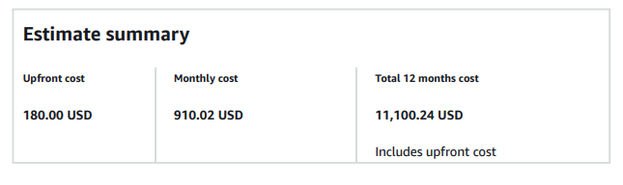
Cost Estimation
The estimated cost for implementing the Smart Traffic Management (STM) system based on the AWS Pricing Calculator is as follows. The upfront cost is $180.00 USD, with a monthly cost totaling $910.02 USD. Considering a 12-month timeframe, the total cost, including the upfront cost, amounts to $11,100.24 USD.

Slide 25
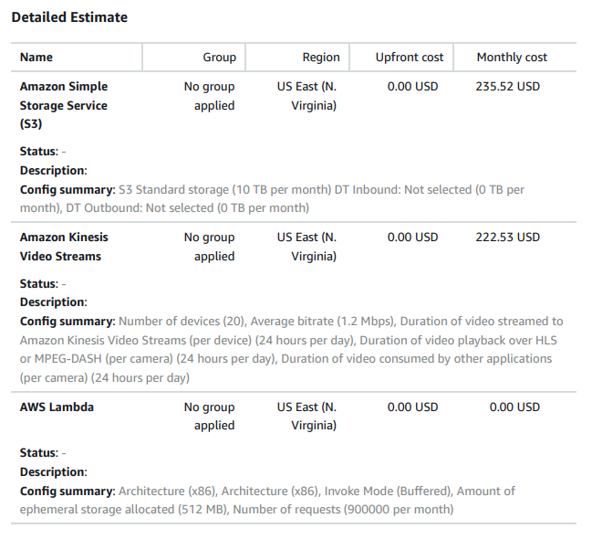

Slide 26
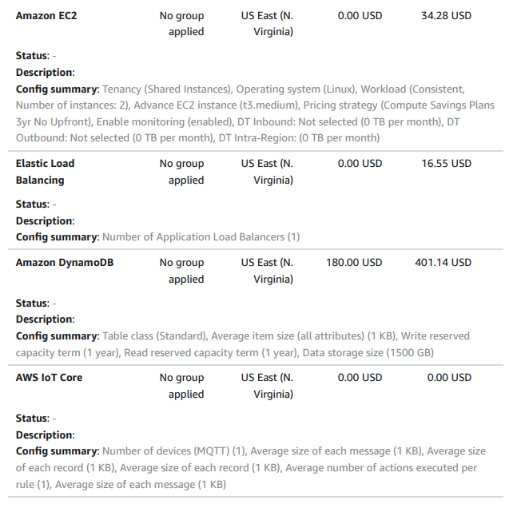

Slide 27
Conclusion
The Smart Traffic Management (STM) system leverages AWS services to create an efficient, scalable, and secure solution for urban traffic management. By dynamically adjusting traffic signal timings based on real-time data, the system aims to reduce congestion, improve mobility, and minimize environmental impact. The designed infrastructure ensures high availability, fault tolerance, and robust data security. Cost estimation indicates that the system is economically viable for large-scale implementation, providing a comprehensive approach to enhancing urban traffic flow.

